Slide 1
Technical and Infrastructure Readiness For Managing the .GOV.NG domain
Presented by
Nosike Agusiegbe
Manager, Data Center and Hosted Services (DCHS)
Galaxy Backbone Plc.
Notes:
1

Slide 2
Main Topics
Main Features of the Galaxy Backbone Infrastructure
Description of the Galaxy Technical platform for managing .gov.ng and DNS services
Human Resource Capacity for managing .gov.ng
Planned Activities for improved Adoption of .gov.ng amongst MDAS.

Slide 3
Main Features of the Galaxy Backbone Infrastructure
Nationwide Communications Network
Currently deployed/implemented a 300km metro optical fibre network in Abuja
Over 3000 VSAT nodes deployed and maintained nationwide
Standard VSAT Hub in Abuja
Primary Datacenter - Fully operational Facility in Abuja
Secondary Datacenter - Currently under construction in Lagos
DC fully equipped with Firewalls, E-mail Gateways, IPSs, SAN, Load Balancers and VMware platform for Cloud Services
Technical and Operational Capacity
Skilled Manpower / Operational Staff
Network Integration , Information Security and Web Hosting Expertise
Adoption ITIL-based Operational Processes and Tools

Slide 4
Data Center and Hosting Infrastructure
A fully equipped ISO 27001 certified facility sitting on 200 square metres of floor space with 200TB of storage capacity.
Designed to deliver world class enterprise data hosting service with in-built redundancy, resilience, and uncompromising security and safety standards
Services available from the DataCentre Include
Infrastructure
Rack Space Hosting
Cloud Services
Virtual Server Hosting
Co-location
Managed Web Hosting
Enterprise Application Hosting
Hosted Messaging & Collaboration
Disaster Recovery & Business Continuity
Storage As A Service

Slide 5
ISO 27001 Certificate

Slide 6
Current Platform for DNS Services and Management of .gov.ng
Galaxy Backbone is now the sole registrar for the .gov.ng and the .mil.ng name spaces.
To support this, Galaxy Backbone has access to the .ng web registry platform (CoCCA) and an internal DNS platform
Galaxy Backbones DNS Servers are currently the Start of Authority (SOA) name servers for approximately 65% of all Federal .gov.ng domains
Our DNS services currently run off a SimpleDNS platform.
The security of this platform is secure following the specific installation, configuration and updating processes along with the inherent DataCenter Information Security layers (Firewalls, IPSs, Application Filters etc) that protect all data Center and hosted services. This facility meets global standards of information security
Reliability iand High Availability is assured because this solution is based on a redundant architecture . The Authoritative, Caching and Hidden DNS roles are replicated between two separate environments.

Slide 7
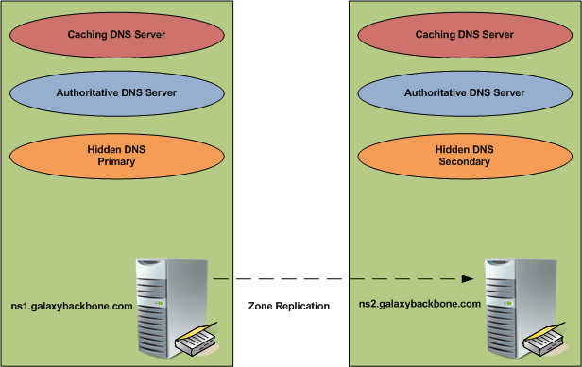
High Level Architecture of Current DNS Platform

Slide 8
Some Features of New DNS Platform
Galaxy’s proposed DNS and IP Address Management (IPAM) solution is purposefully designed to significantly improve the management of .gov.ng, .mil.ng and the associated DNS Zones
By automating and streamlining DNS management processes, Galaxy Backbone will be able to eliminate DNS configuration errors and to save 50-60% of the time spent on DNS and IPAM related network management tasks.
This Appliance-based DNS infrastructure will allow Galaxy Backbone to attain six-sigma (99,9999%) availability for Galaxy’s DNS services.
Platform is capable of handling 3000+ queries per second and is designed to separate Authoritative, Caching and Recursive functions into separate appliances. The result of these attributes will be significant improvement in performance.
The product and its design enhances our ability to mitigate against DNS attacks like Spoofing, Port Flooding etc.

Slide 9
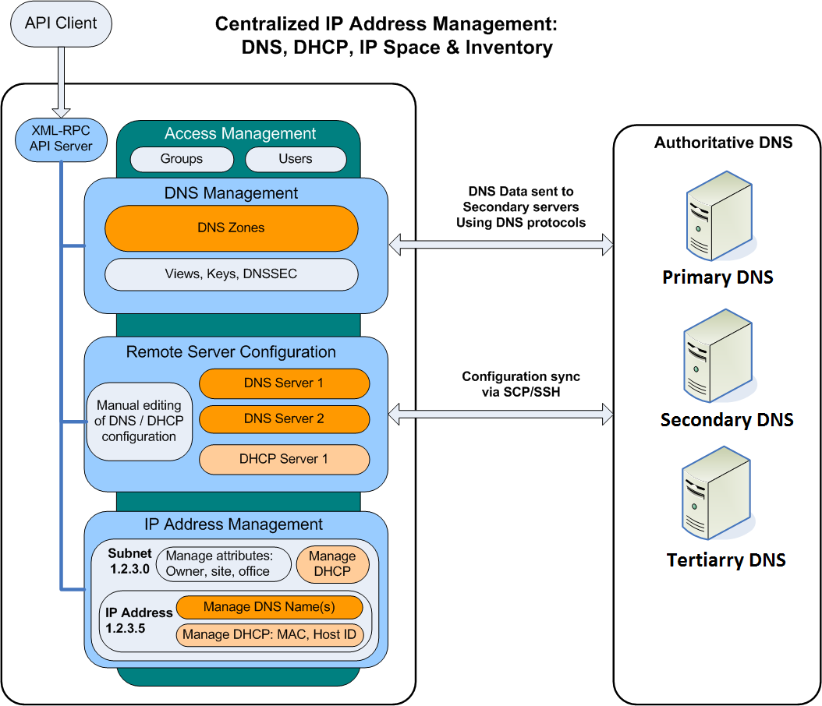
High Level Diagram for new DNS Platform

Slide 10
Human Resource Capacity for managing .gov.ng
Well trained team that are already experienced at working on Internet services such as e-Mail, Websites and Web Applications
Team already familiar with DNS Services, DNS Architecture, DNS configurations and Zone file management
Galaxy engineers are already familiar with the CoCCA platform for registering and managing domains
Our engineers are booked to be trained on the new DNS and IPAM solution being procured for efficient on-going operations
We have a plan in place to get our team more involved in NIRA activities and the collaborative efforts of the Registry, Registrars and Registrants.

Slide 11
High level Process Workflow for domain registration

Slide 12
Planned activities for increased adoption of .gov.ng amongst MDAS.
Utilize our existing relationships with the MDAs with primary focus on engaging technical and administrative decision makers.
Work with the Ministry of Communication Technology on Sensitization as well as Change Management for DNS and registry migrations
Effectively communicate to stakeholders the benefits of utilizing a common and uniform domain(.gov.ng) for transacting business.
Ensure operational support procedures are clear and unambiguous for all relocated/transferred domains.

Slide 13
Thanks for Listening.
Questions??

